Slide 1
Aru Examination Management System
Name: Mudhihir H. Nyema.
Reg No: 26990/T.2021
Insert supervisor’s names
1.Mr Yohana Kangwe.
2. Mr Alexander Moreka.

Slide 2
Problem statement
1.0 Context
i. At ardhi university ends of each semester examination took place, but these examination done or took place locally with manual process, that will result to lack of real-time tracking of exam booklets, manual data entry leading to errors and delays. Therefore through that situation I proposed to develop aru examination management system to streamline and to solve these manual activities through automated system.

Slide 3
1.2 .Relevance
i.It help to reduce data entry errors especially on counting and record booklet numbers.
ii. Help to to keep track cost estimation at the ends of each of studies what booklet used not used.

Slide 4
2.0 General Objective i. The general objective of this dissertation is to develop aru examination management System.
2.1 Specific objective
i. To gathering information for aru examination management system.
ii. To design aru examination management system.
iii. To implement aru examination management system.
iv. To test and validate aru examination management system.

Slide 5
3.0 Methodology
Specific objective | Research question | Method | Tool | Deliverable
To gather requirement for aru examinations management system. | How can I gather user requirement for aru examinations management system. | Literature review and Questionnaire | Google scholar and Google form | User requirements specification document
To design aru examinations management system. | What techniques can I use to design aru examinations management system? | Objective oriented system analyst and design methodoly. | Draw.io | System designs document
To implement aru examinations management system. | How can I implement aru examinations management system. | Waterfall method. | Html,CSS(Tailwind),Javascript,Flutter,Xammp server,Sql,MysQl,Androis studio,Php,Vs code, | Aru management system.
To testing and validate aru examinations management system. | What techniques can I use to implement aru examinations management system. | Integration test | Personal computer,Android studio,Vs code and Xammp server | Test and validate results

Slide 6
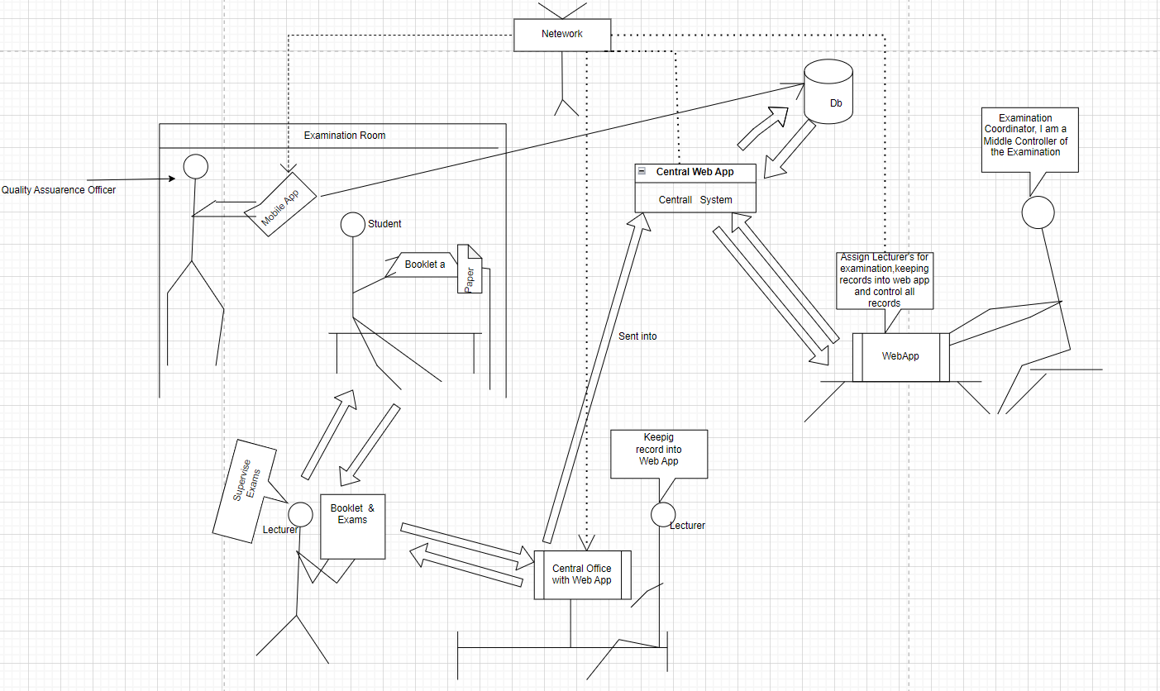
3.1Architecture design

